Slide 1
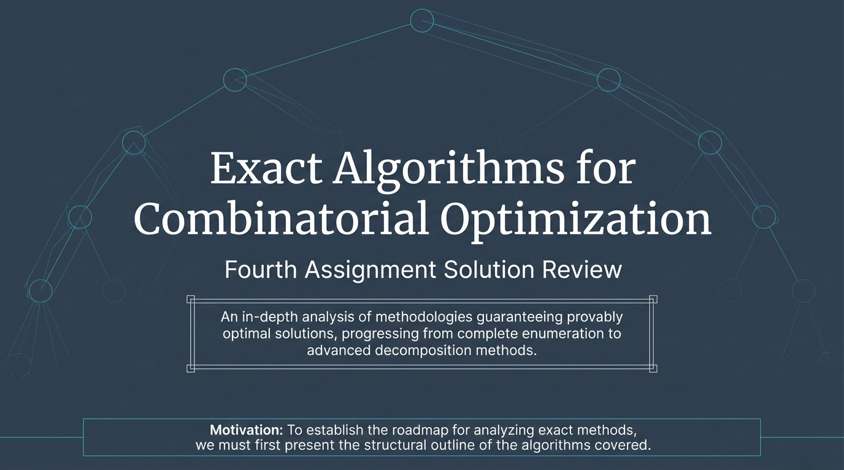
Notes:
Slide 1: Title Slide "Welcome to this presentation on Exact Algorithms for Combinatorial Optimization, which serves as our fourth assignment solution review. In this session, we will provide an in-depth analysis of methodologies that guarantee provably optimal solutions, progressing from complete enumeration all the way to advanced decomposition methods. To establish the roadmap for analyzing these exact methods, we must first present the structural outline of the algorithms covered

Slide 2
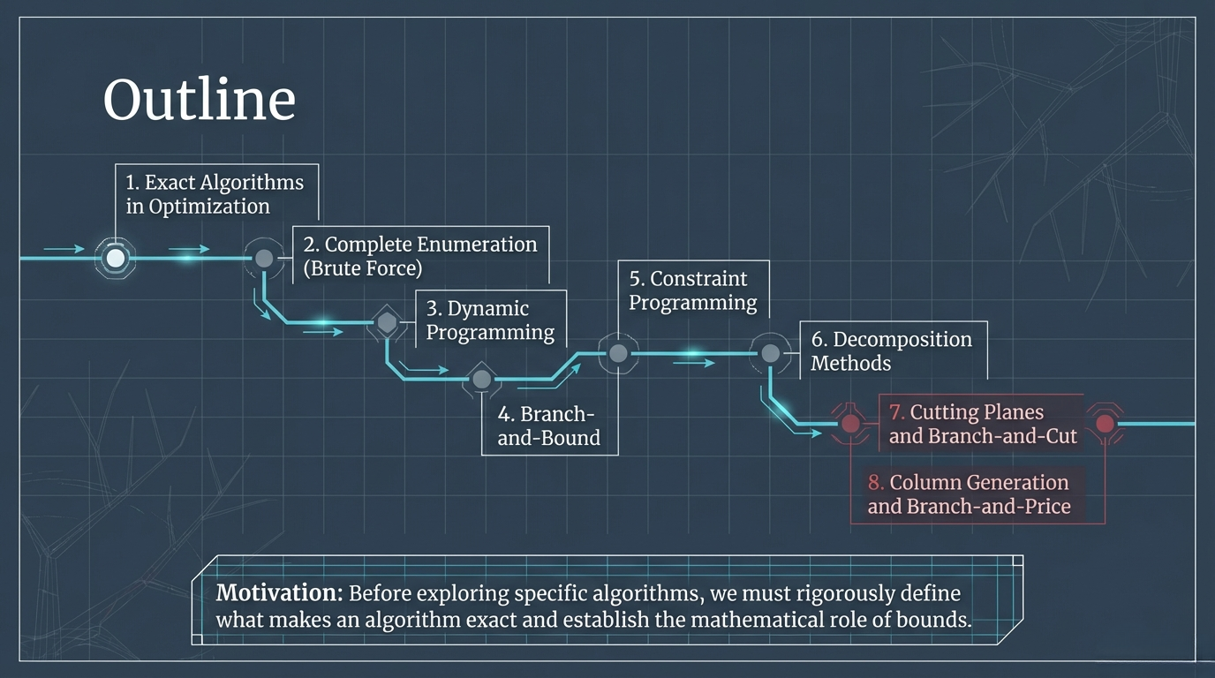
Notes:
Slide 2: Outline "Our outline is structured into 8 main sections. We will start with an overview of Exact Algorithms in Optimization, followed by Complete Enumeration, also known as Brute Force. Then we will cover Dynamic Programming, Branch-and-Bound, and Constraint Programming. Finally, we will delve into advanced topics including Decomposition Methods, Cutting Planes and Branch-and-Cut, and Column Generation and Branch-and-Price. Before exploring specific algorithms, we must rigorously define what makes an algorithm exact and establish the mathematical role of bounds

Slide 3
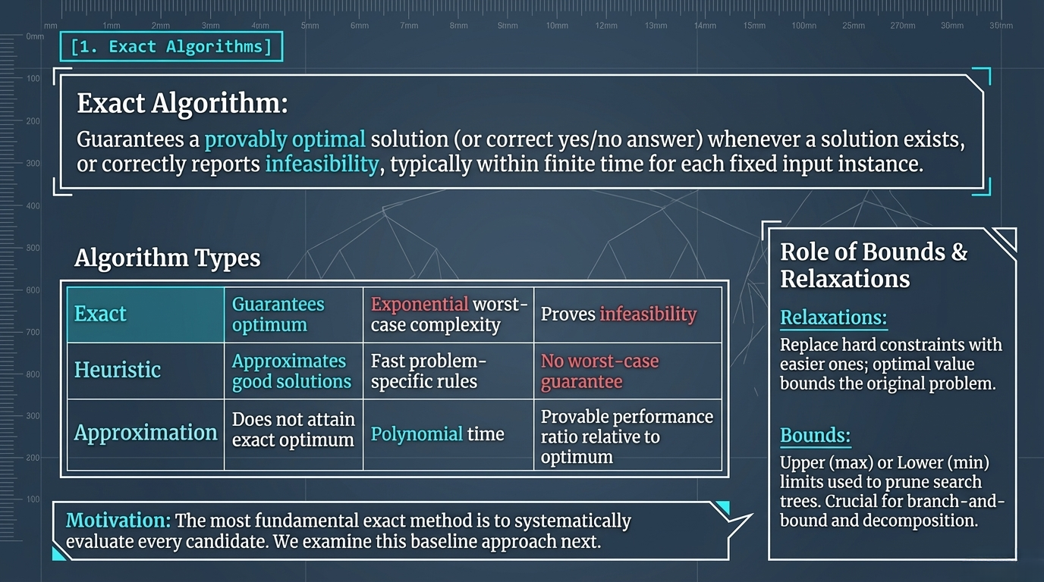
Notes:
Slide 3: Exact Algorithms "So, what is an exact algorithm? It is a method that guarantees a provably optimal solution—or a correct yes/no answer—whenever a solution exists, or correctly reports infeasibility, typically within finite time for a fixed input instance. Unlike heuristics that approximate good solutions without worst-case guarantees, or approximation algorithms that run in polynomial time but do not attain the exact optimum, exact algorithms guarantee the optimum but usually have exponential worst-case complexity. A crucial concept here is the role of bounds and relaxations: relaxations replace hard constraints with easier ones to bound the original problem, while bounds provide upper or lower limits used to prune search trees. The most fundamental exact method is to systematically evaluate every candidate, and we will examine this baseline approach next."

Slide 4
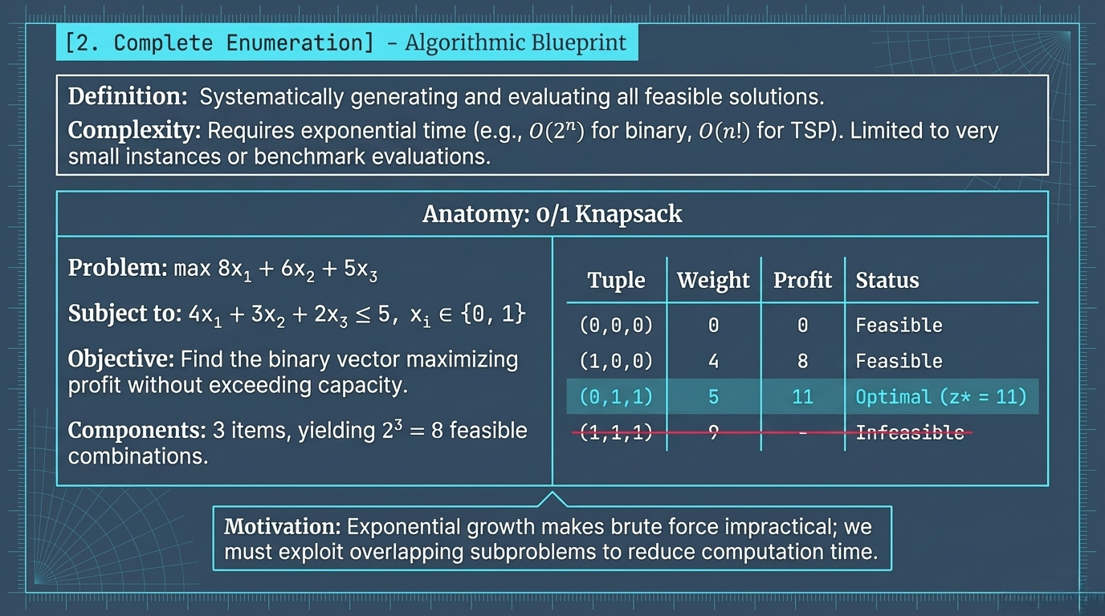
Notes:
Slide 4: Complete Enumeration "Complete Enumeration, or brute force, is defined by systematically generating and evaluating all feasible solutions. However, its complexity requires exponential time—such as O(2n) for binary problems or O(n!) for the TSP—which limits its use to very small instances or benchmark evaluations. For example, in a 0/1 Knapsack problem with 3 items, we have 23=8 feasible combinations. By evaluating them, we can easily see that the tuple (0,1,1) yields the optimal profit of 11. Because exponential growth makes brute force impractical, we must exploit overlapping subproblems to reduce computation time."

Slide 5
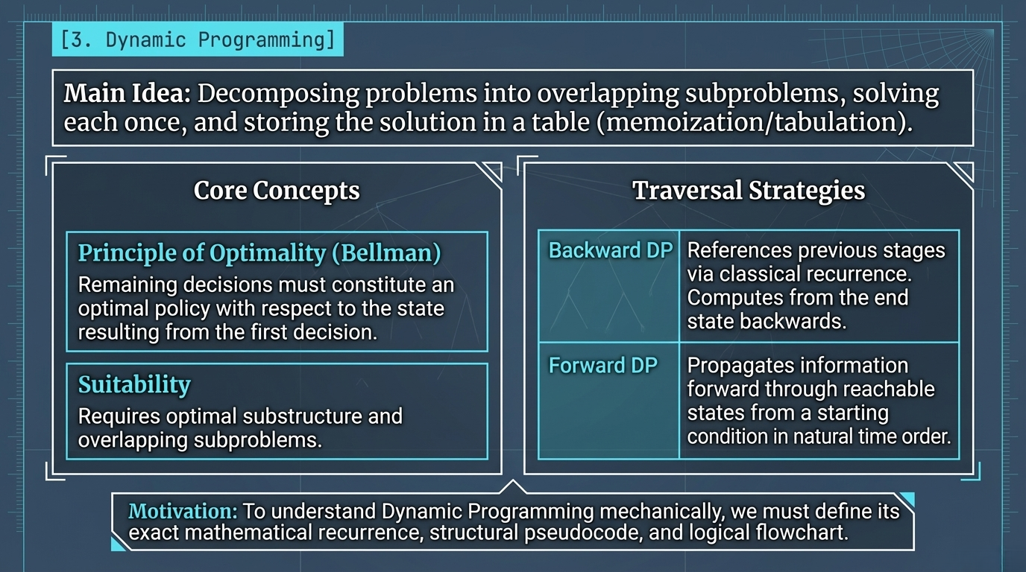
Notes:
Slide 5: Dynamic Programming (Concepts) "This brings us to Dynamic Programming. The main idea here is decomposing problems into overlapping subproblems, solving each once, and storing the solution in a table through memoization or tabulation. The core of DP is Bellman's Principle of Optimality, which states that remaining decisions must constitute an optimal policy with respect to the state resulting from the first decision. For traversal strategies, we can use Backward DP, computing from the end state backwards via classical recurrence, or Forward DP, which propagates information forward in natural time order. To understand Dynamic Programming mechanically, we must define its exact mathematical recurrence, structural pseudocode, and logical flowchart."

Slide 6
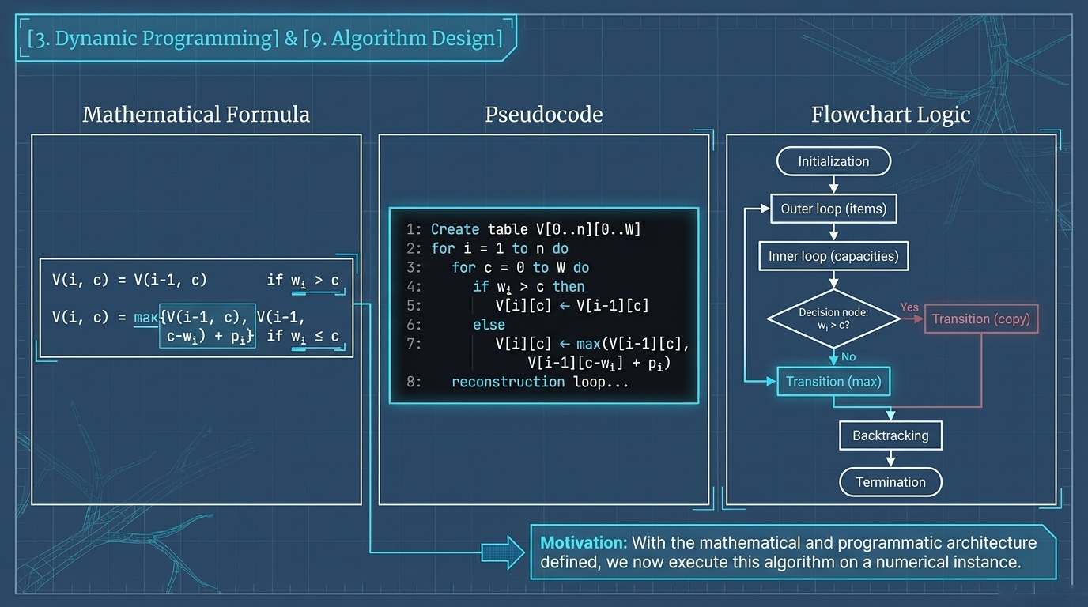
Notes:
Slide 6: Dynamic Programming & Algorithm Design "Here we see the formalized architecture of Dynamic Programming. The mathematical formula establishes the state transition, usually taking a maximum or minimum of previous states. The pseudocode illustrates the algorithmic implementation, creating a table and looping through items and capacities to fill it. The flowchart logic clearly visualizes this: from initialization, through outer and inner loops, decision nodes, and transitions, all the way to backtracking and termination. With the mathematical and programmatic architecture defined, we now execute this algorithm on a numerical instance."

Slide 7
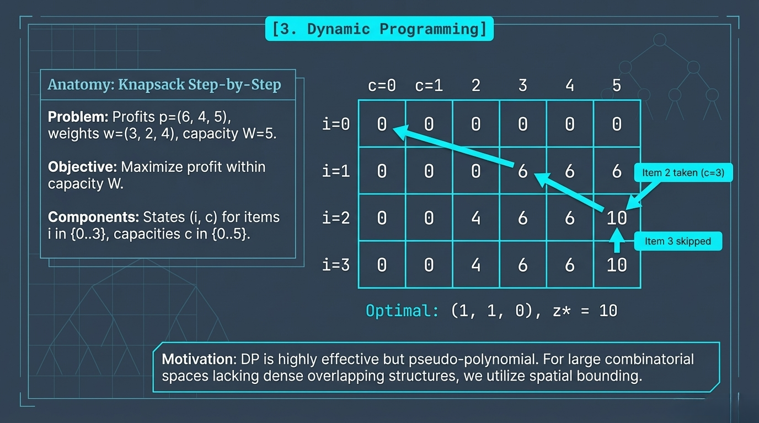
Notes:
Slide 7: DP Anatomy (Knapsack Step-by-Step) "Let's look at a step-by-step example of the Knapsack problem. Our objective is to maximize profit within a capacity of W=5, given specific item profits and weights. We set up our states (i, c) for items and capacities in a grid. By systematically filling the table, we find our optimal solution yields a maximum profit of 10, achieved by taking item 2 and item 3. While DP is highly effective, it is pseudo-polynomial. For large combinatorial spaces lacking dense overlapping structures, we must utilize spatial bounding."

Slide 8
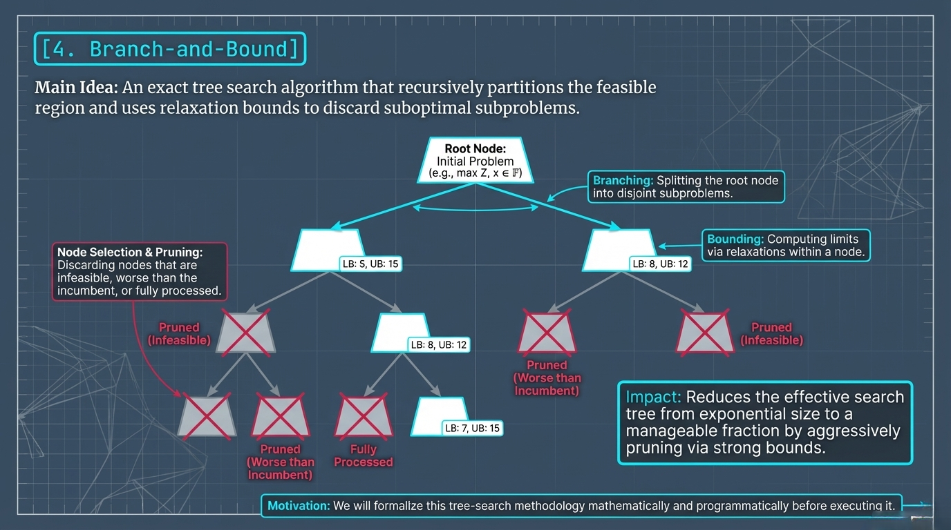
Notes:
Slide 8: Branch-and-Bound "Branch-and-Bound is an exact tree search algorithm that recursively partitions the feasible region and uses relaxation bounds to discard suboptimal subproblems. From a root node, we perform 'Branching' by splitting the node into disjoint subproblems. At each node, we perform 'Bounding' to compute limits via relaxations. Nodes are pruned if they are infeasible, worse than the current incumbent, or fully processed. This aggressively prunes the search tree and reduces it from an exponential size to a manageable fraction. We will formalize this tree-search methodology mathematically and programmatically before executing it."

Slide 9
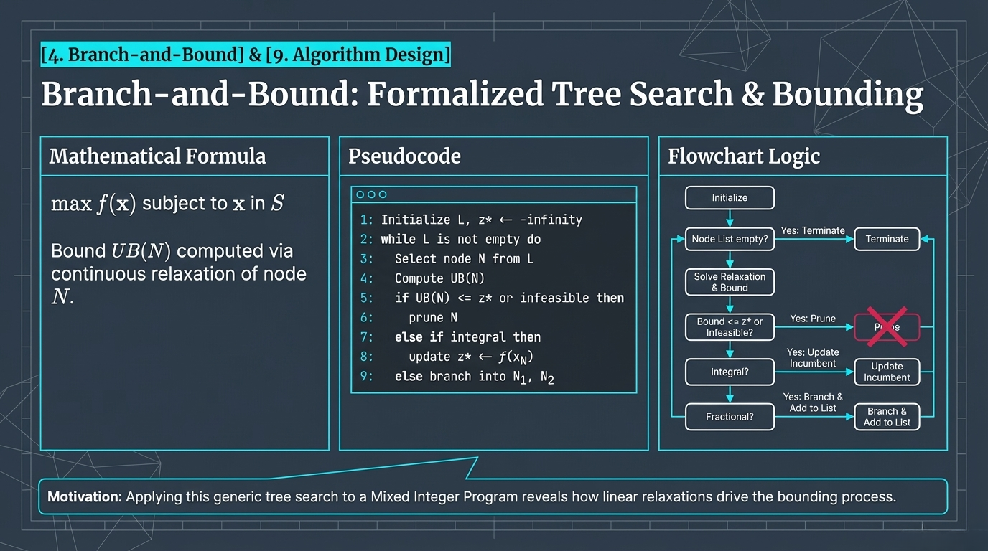
Notes:
Slide 9: Branch-and-Bound Formalized "Formalizing Branch-and-Bound, our mathematical goal is to maximize f(x) subject to x in S, computing bounds via continuous relaxation of nodes. The pseudocode outlines a 'while' loop that selects nodes, computes bounds, prunes them if they are infeasible or worse than the incumbent, updates the incumbent if an integral solution is found, or branches otherwise. The flowchart mirrors this recursive logic. Applying this generic tree search to a Mixed Integer Program reveals how linear relaxations drive the bounding process."

Slide 10
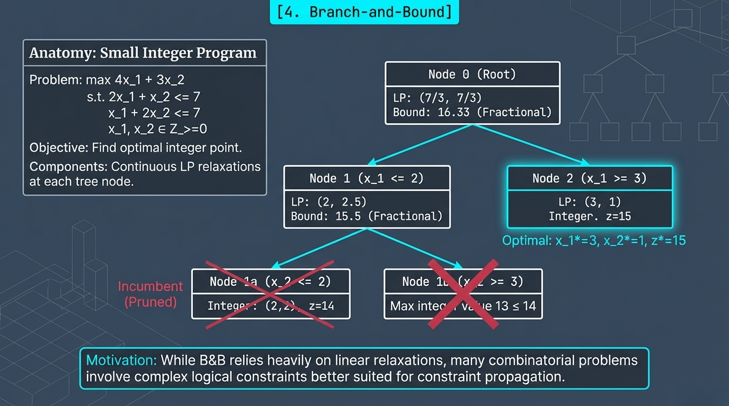
Notes:
Slide 10: Branch-and-Bound Anatomy "Let's trace a small Integer Program through the Branch-and-Bound tree. At the root node (Node 0), the continuous LP relaxation gives a fractional bound of 16.33. We then branch based on x1​ being ≤2 or ≥3. At Node 2, the LP yields an integer solution of 15, which becomes our incumbent. Other branches, like Node 1a and 1b, yield bounds less than 15, allowing us to prune them. While B&B relies heavily on linear relaxations, many combinatorial problems involve complex logical constraints better suited for constraint propagation."

Slide 11
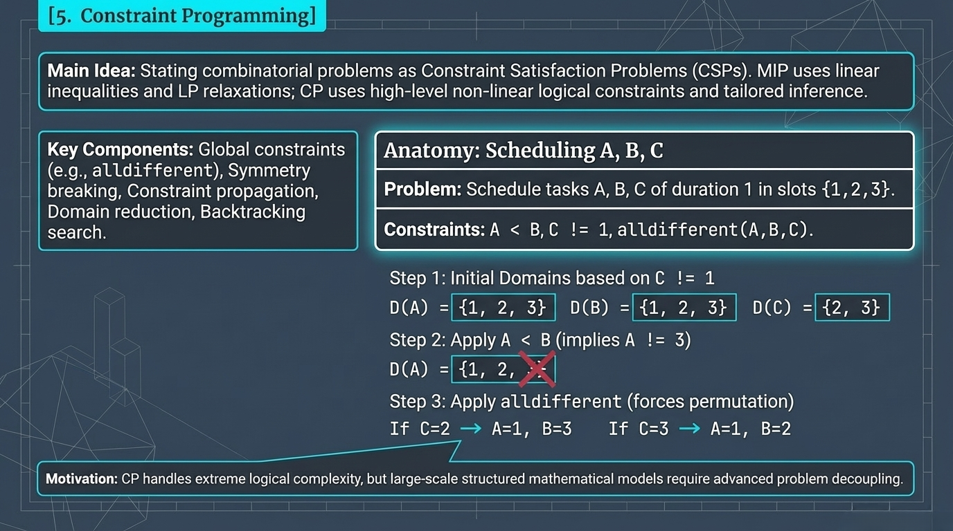
Notes:
Slide 11: Constraint Programming "Constraint Programming (CP) states combinatorial problems as Constraint Satisfaction Problems. While MIP uses linear inequalities and LP relaxations, CP uses high-level non-linear logical constraints and tailored inference. Key components include global constraints like 'alldifferent', symmetry breaking, constraint propagation, and backtracking search. In our scheduling example, simple logical rules like A < B and 'alldifferent' rapidly reduce variable domains without the need for algebraic equations. CP handles extreme logical complexity, but large-scale structured mathematical models require advanced problem decoupling."

Slide 12
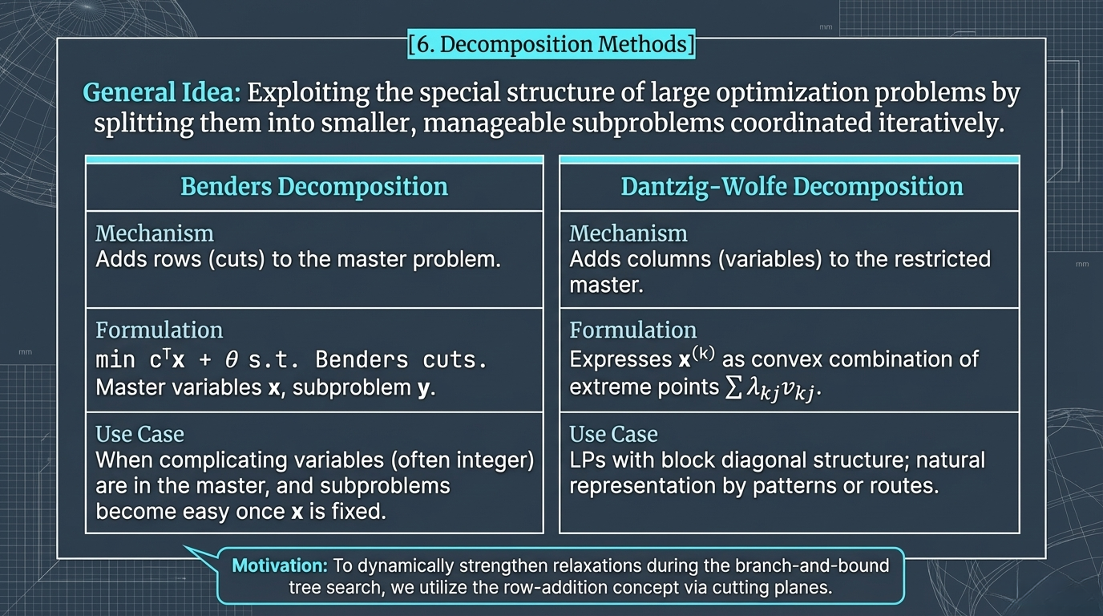
Notes:
Slide 12: Decomposition Methods "This brings us to Decomposition Methods. The general idea is to exploit the special structure of large optimization problems by splitting them into smaller, manageable subproblems coordinated iteratively. Benders Decomposition adds rows or cuts to the master problem, which is useful when complicating integer variables are in the master, making subproblems easy once fixed. Dantzig-Wolfe Decomposition adds columns or variables to the restricted master problem, expressing variables as convex combinations of extreme points, which is ideal for block diagonal structures. To dynamically strengthen relaxations during the branch-and-bound tree search, we utilize the row-addition concept via cutting planes

Slide 13
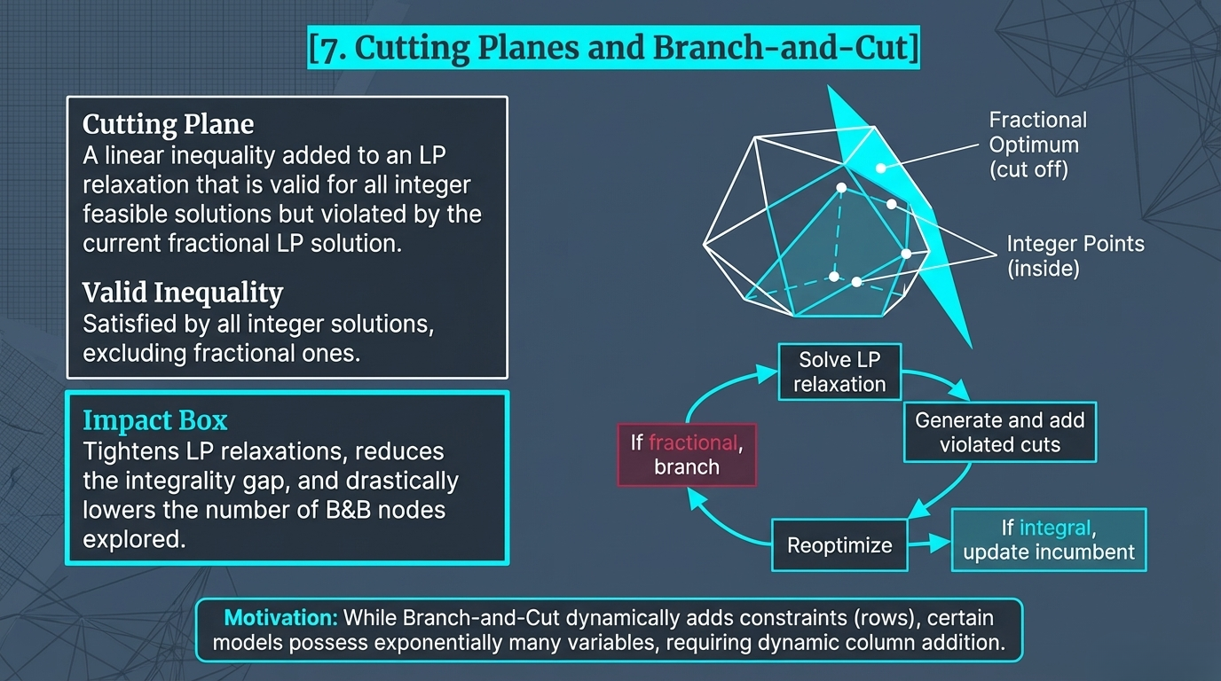
Notes:
Slide 13: Cutting Planes and Branch-and-Cut "A Cutting Plane is a linear inequality added to an LP relaxation that is valid for all integer feasible solutions but is violated by the current fractional LP solution. Adding these valid inequalities creates an impact box that tightens LP relaxations, reduces the integrality gap, and drastically lowers the number of B&B nodes explored. The algorithm solves the LP relaxation, generates and adds violated cuts if fractional, and branches if no cuts are found. While Branch-and-Cut dynamically adds constraints (rows), certain models possess exponentially many variables, requiring dynamic column addition."

Slide 14
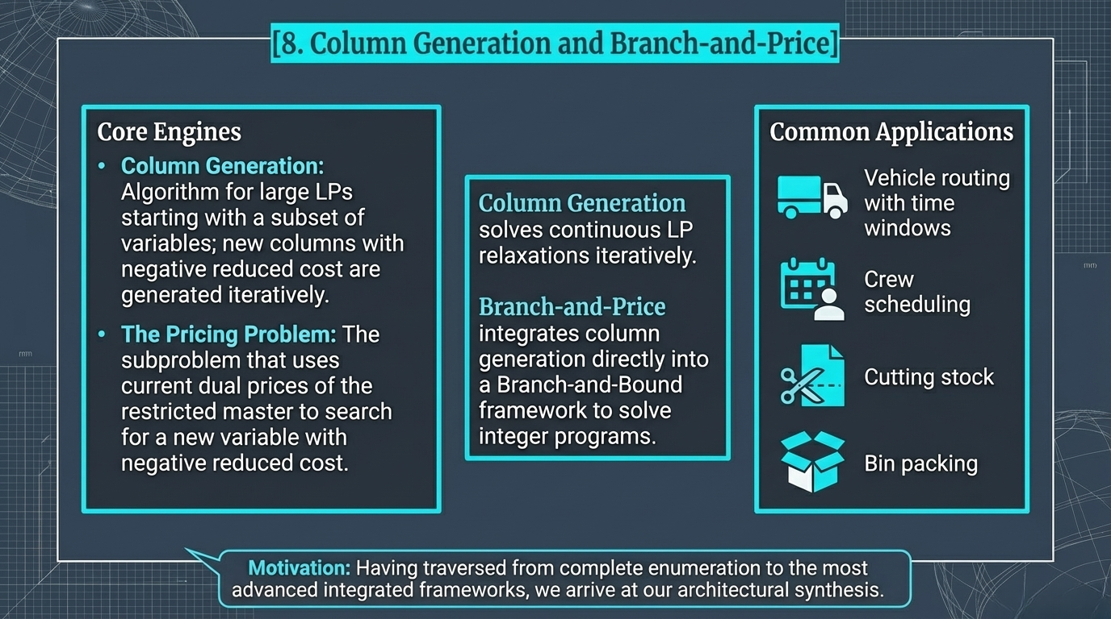
Notes:
Slide 14: Column Generation and Branch-and-Price "For these models, we use Column Generation and Branch-and-Price. Column Generation solves large LPs by starting with a subset of variables; the Pricing Problem then uses current dual prices to search for a new variable with a negative reduced cost. Branch-and-Price integrates this column generation directly into a Branch-and-Bound framework to solve integer programs. Common applications include vehicle routing with time windows, crew scheduling, cutting stock, and bin packing. Having traversed from complete enumeration to the most advanced integrated frameworks, we arrive at our architectural synthesis

Slide 15
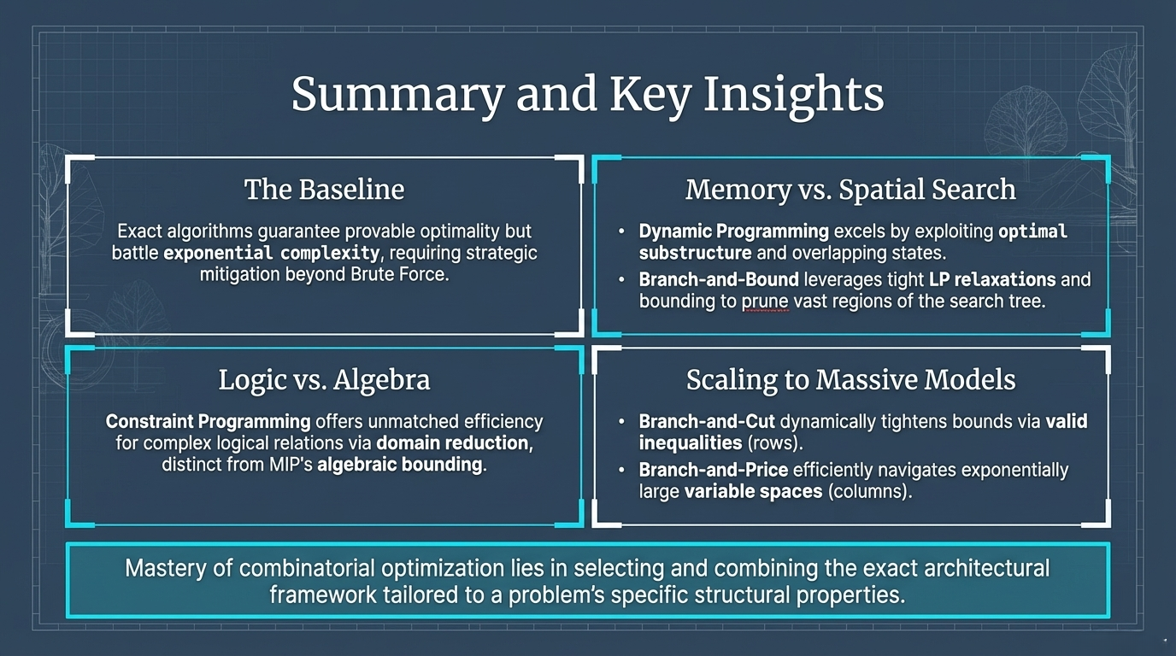
Notes:
Slide 15: Summary and Key Insights "To summarize our key insights: The baseline is that exact algorithms guarantee provably optimal solutions but battle exponential complexity, requiring strategic mitigation beyond Brute Force. Regarding Logic vs. Algebra, Constraint Programming offers unmatched efficiency for complex logical relations via domain reduction, distinct from MIP’s algebraic bounding. For Memory vs. Spatial Search, Dynamic Programming excels by exploiting optimal substructure, while Branch-and-Bound leverages tight LP relaxations to prune vast regions of the search tree. Finally, for scaling to massive models, Branch-and-Cut dynamically tightens bounds via rows, and Branch-and-Price efficiently navigates exponentially large variable spaces via columns. Mastery of combinatorial optimization lies in selecting and combining the exact architectural framework tailored to a problem’s specific structural properties. Thank you."

